Slide 1
Name: S.DHINESHKUMAR
NM id: au730321104010
Reg. No: 730321104010
Year: III
Department: BE/COMPUTER SCIENCE AND ENGINEERING
College Name: BUILDERS ENGINEERING COLLEGE
3/21/2024
Annual Review
1

Slide 2
PROJECT TITLE
Hand Gesture Virtual Mouse
3/21/2024
Annual Review
2

Slide 3

1. Introduction to Hand Gesture Virtual Mouse.
2. Technologies and Tools.
3. Hardware Requirements.
4. Software Development
5. Algorithm.
6. Use Cases and Applications.
7. Conclusion.
AGENDA
3/21/2024
Annual Review
3

Slide 4

PROBLEM STATEMENT
In today's digital age, traditional computer mice are ubiquitous but limited in their functionality and user experience. Many users struggle with the constraints of physical mice, such as space limitations, accuracy issues, and the need for additional accessories like mouse pads. Moreover, individuals with mobility impairments may find it challenging to use conventional mice effectively.
Key Challenges:
1. Gesture Recognition Accuracy.
2. User Adaptation.
3. Compatibility and Accessibility.
3/21/2024
Annual Review
4

Slide 5

PROJECT OVERVIEW
Hand Gesture Virtual Mouse – Enhanced mouse interaction
and user experience.
Software developed using Python.
Hardware Requirements – Web camera.
This can works with different multiple image processing
techniques.
Media Pipe Framework – Hand Gesture Tracking.
OpenCV library – Computer Vision.
Algorithm – Transformational Algorithm.
3/21/2024
Annual Review
5

Slide 6

WHO ARE THE END USERS?
1. General Computer Users
2. Gamers
3. People with Disabilities
4. Designers and Artists
5. Healthcare Professionals
3/21/2024
Annual Review
6

Slide 7

YOUR SOLUTION AND ITS VALUE PROPOSITION
Solution:
Natural and intuitive way of interactions, dynamic user experience.
Value Proposition:
Facilitate creative expression, Enhances user comfort and ergonomics.
3/21/2024
Annual Review
7

Slide 8

THE WOW IN YOUR SOLUTION
1. Contactless Interaction
2. 3D Gesture Recognition
3. Multi-Modal Input
4. Customizable Gestures
5. Cross-Platform Compatibility
3/21/2024
Annual Review
8

Slide 9
MODELLING
Relationships:
There are two main processes in the system:
Hand Detection: This process takes a Hand Image/Video frame as input and outputs the Hand Landmarks.
Gesture Recognition: This process takes the Hand Landmarks as input and outputs the Gesture Information.
One-to-Many:
A single Hand Image/Video frame can have multiple Hand Landmarks identified within it (one-to-many relationship).
One-to-One:
A set of Hand Landmarks corresponds to a single Gesture Information (one-to-one relationship).
3/21/2024
Annual Review
9

Slide 10
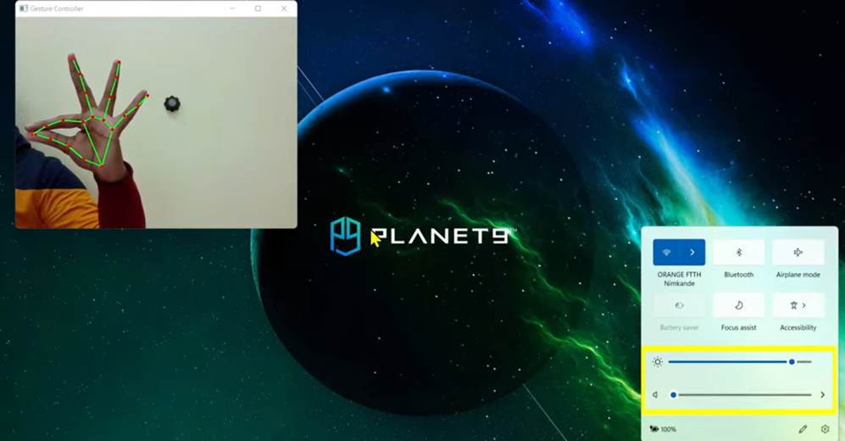
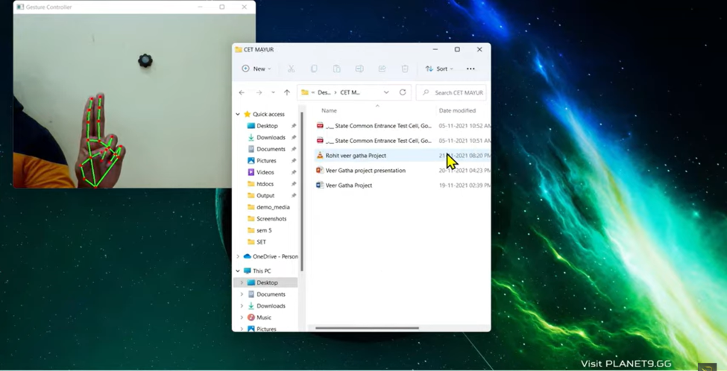
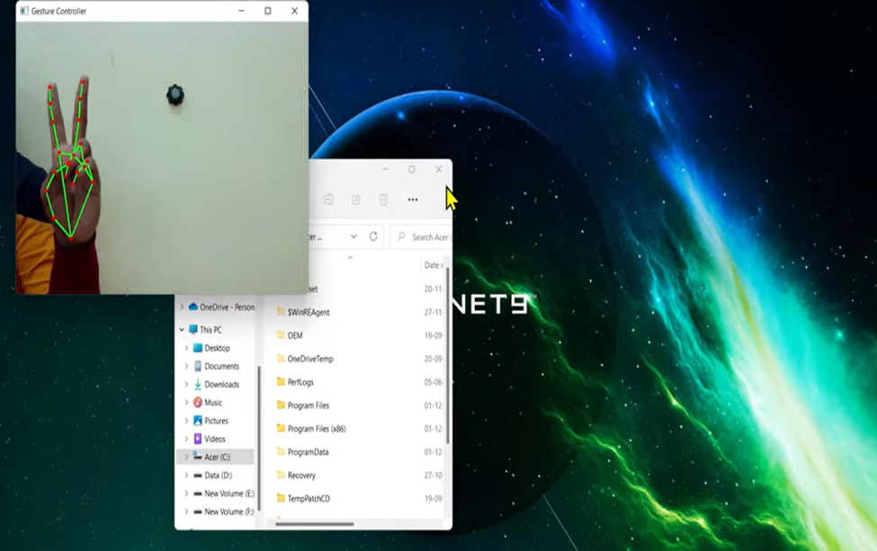
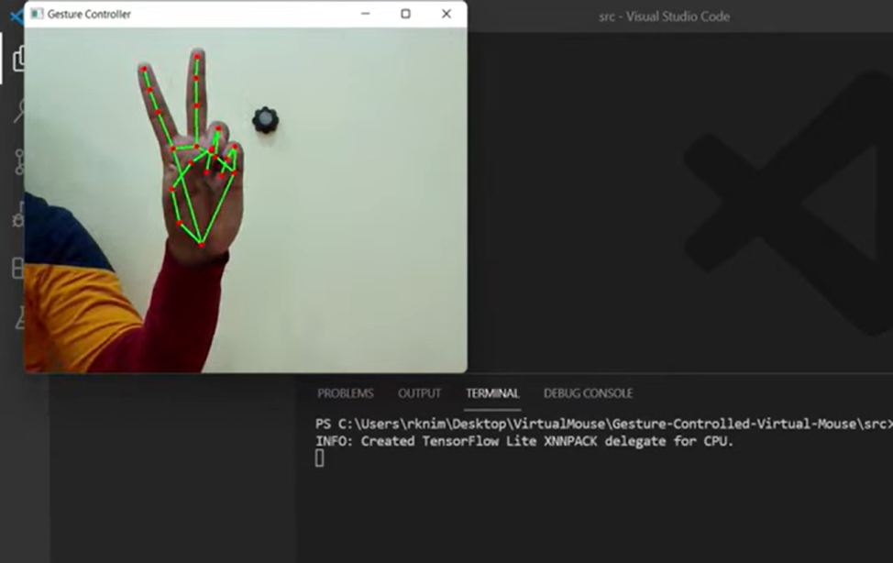
RESULTS
Demo link :

